Slide 1
Networking: keeping you connected to THE things that matter
*

Slide 2
?
Notes:
At this point I ask the audience the rhetorical question “What are the things that really matter?”

Slide 3

Globalization?
Notes:
I mention globalization and act dismissive towards its importance.

Slide 4

Climate Change?
Notes:
I dismiss the topic of climate change since “I am looking forward to having beachfront property in Winnipeg”

Slide 5
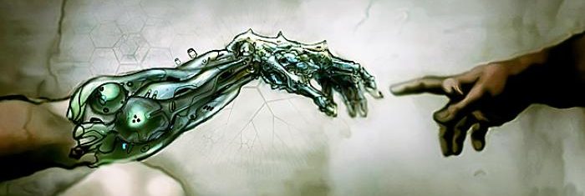
Transhumanism?
Notes:
I dismiss transhumanism saying most people in the room have probably never heard of it.

Slide 6
?
Notes:
Repeat the rhetorical question.

Slide 7
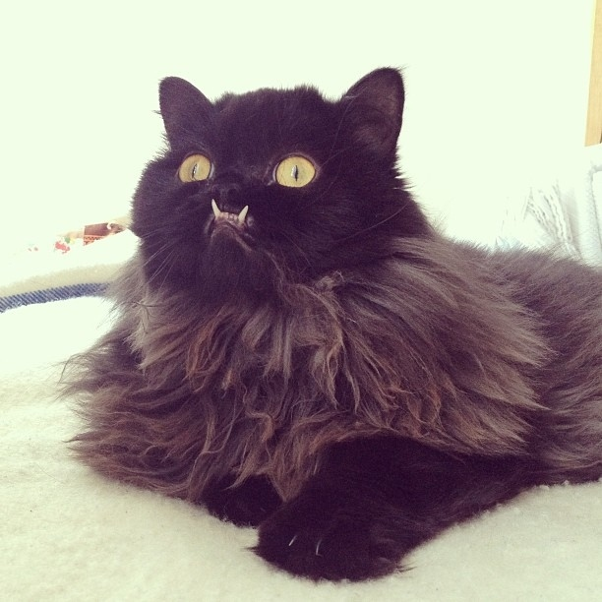
Cat Pictures!
BTW: Her name is Princess Monster Truck
Notes:
Point out that what REALLY matters is Cat pictures, and getting them to the student’s phones/laptops

Slide 8
ACRONYM STEW
NAT
STP
DNS
EIGRP
UDP
IPv4
PAT
DHCP
TCP
BGP
OSPF
OSPF
IPv6
RJ45
Wifi

Slide 9
ACRONYM STEW
NAT
STP
DNS
EIGRP
UDP
IPv4
PAT
DHCP
TCP
BGP
OSPF
OSPF
IPv6
RJ45
Wifi

Slide 10
ACRONYM STEW
NAT
STP
DNS
EIGRP
UDP
IPv4
PAT
DHCP
TCP
TCP
BGP
OSPF
OSPF
IPv6
RJ45
Wifi

Slide 11
IP Addresses
Your computer’s Logical Address
Like a street address
Packets are sent addressed to a specific “house/host” which is located on a specific “street/network”
Routers read packets, and sends them in the direction toward the network the packet is addressed to.

Slide 12


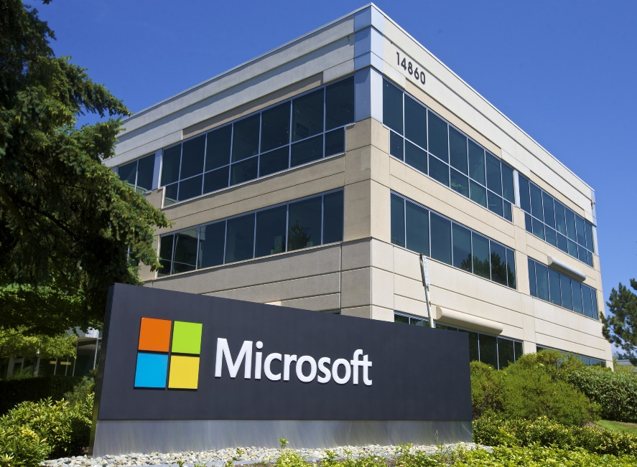

INTRODUCTION
This is Packet the cat, she is a wandering soul that is always looking for a new destination
(you should see her Instagram)

Slide 13



Routing - Continued
Source IP Address: 10.10.0.6
Destination IP Address:
192.168.2.254
10.10.0.1 Street
192.168.2.0 Street
Lot 254
10.10.0.0 Street
192.168.1.0 Street
Lot 6

Slide 14
Routing – Your Network
Source IP Address: 10.18.35.2
Destination IP Address:
10.18.35.25
10.18.35.0 Street
Lot 2
Lot 25

Slide 15

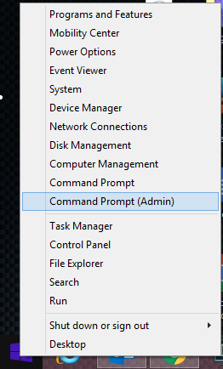
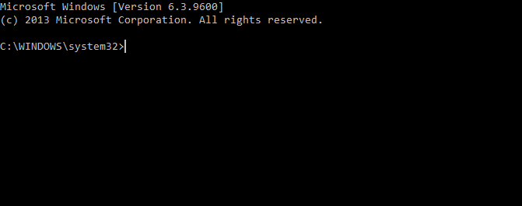
What’s my ip address?
Right-click on your start-menu (lower left corner of your screen)
In the menu that pops up, left-click on Command Prompt (Admin). This will open a command prompt window (see below).

Slide 16
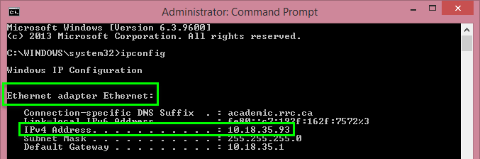
What’s my ip address?
In the command prompt, type ipconfig. This will produce a lot of output, but we only care about some of the information.
You are looking for an Adapter named ”Ethernet Adapter Ethernet:”. Once you locate it, look at the IPv4 Address listed below it to find your IP Address.

Slide 17





Viewing a website
Now that we’ve figured out your IP addresses, you can view your classmates’ websites.
First, open up a web browser (see icons below) by left-clicking on your browser of choice’s icon on the taskbar (the redish purple bar at the bottom of the screen).

Slide 18


Viewing a website
Once the browser opens, you will see the Address bar (see below)
In that box, enter http:// followed by the ip address of one of your classmates, then hit the Enter key.
Google Chrome Address Bar
Firefox Address Bar

Slide 19
?

Slide 20
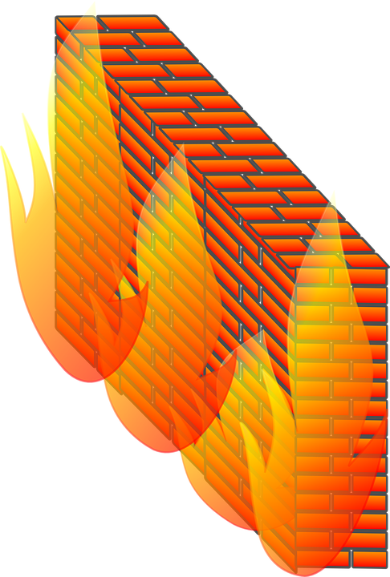


Slide 21


Slide 22
Firewalls
Firewalls are a set of rules on a computer that determine what computers and apps your computer is allowed to talk to.
By default the Windows firewall is configured to block everything coming in except the items on its exception list (items going out are unaffected).
We’ll need to add an exception to your firewall in order to allow others to access your website.

Slide 23
Logical ports – TCP/UDP
An IP Address is used to determine WHERE you are sending the message to.
Port numbers are used to determine WHO you are talking to.
Different apps are listening on different ports.
Most web servers communicate on ports 80 or 8080
Secure Websites using the HTTPS protocol use port 443 (For instance google encrypts the searches you perform so that only they know what you are searching for)
We are to add an exception on your firewall for port 80 (TCP)

Slide 24

HTTP (Webserver)
HTTPS (Encrypted Webserver)
23
Telnet
POP3 (Email Server)
110
443
DNS (Name Server)
80
53

Slide 25


80

Slide 26
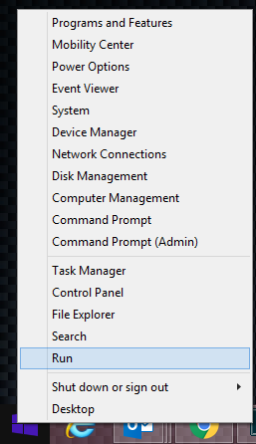
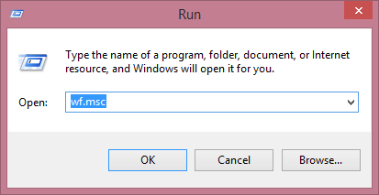
Firewalls – adding an exception
Right-click on your start menu again and left-click on Run
In the run dialog (see below), enter wf.msc and press OK. This will open the Windows Firewall with Advanced Security tool.

Slide 27
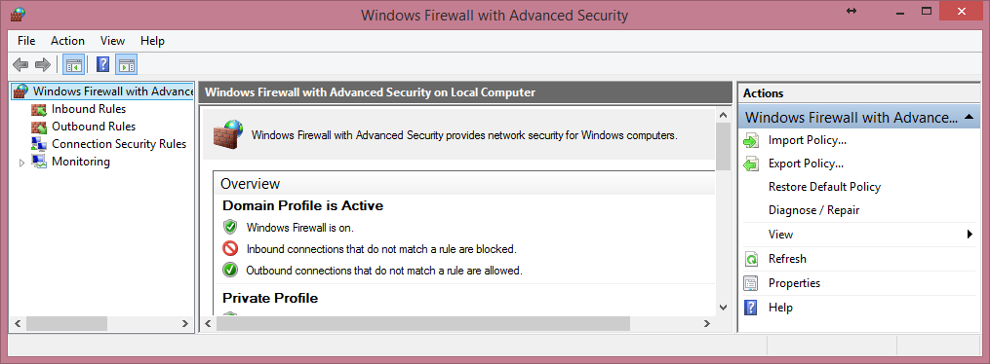
Firewalls – adding an exception

Slide 28
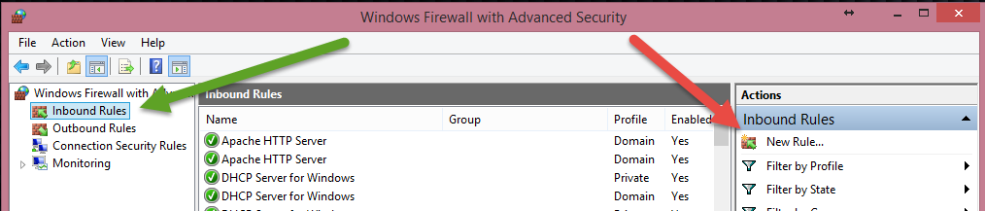
Firewalls – adding an exception
In the panel on the left, left-click on Inbound Rules (Green arrow)
In the Actions panel on the right, left-click on New Rule… (Red Arrow). This will open the New Inbound Rule wizard.

Slide 29
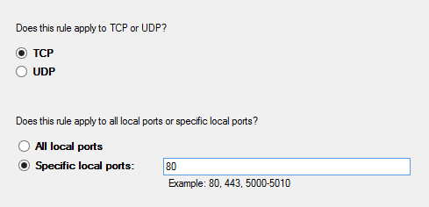
Firewalls – new inbound rule
For Rule Type select Port and click Next >.
This rule applies to TCP.
This rule applies to a Specific local port
In the local port textbox, enter 80
Click Next >

Slide 30
Firewalls – new inbound rule
The Action that should be taken is Allow the connection.
Click Next >.
For “When does this rule apply?”, leave all of the boxes checked/enabled and click Next >
For the name of your rule, enter Website – TCP Port 80 Exception.
Leave the description blank and click Finish

Slide 31

Have Fun!
Now you can go back to edge and enter your classmates’ IP addresses again to see their websites!

